Slide 1
ONE GROUP (H₀)
MANY GROUPS (H_{A})
PREDICTED VALUES
RESIDUALS

Slide 2
When there is only a column of ones, the vector of coefficients is the mean vector.

Slide 3
When there is only a column of ones, the vector of coefficients is the mean vector.
When there are additional columns of dummy variables, the first column vector of coefficients is the mean for group 1; the rest are change vectors to describe other group means.

Slide 4
Predicted values are group means, whether there is one group or more.

Slide 5
Residuals describe within-group dispersion.
Diagonal of outer-product of error represents distances from the mean.
Anderson MJ (2001). Austral Ecology 26: 32-46

Slide 6
Null Hypothesis
Viable test statistics
Anderson MJ (2001). Austral Ecology 26: 32-46

Slide 7
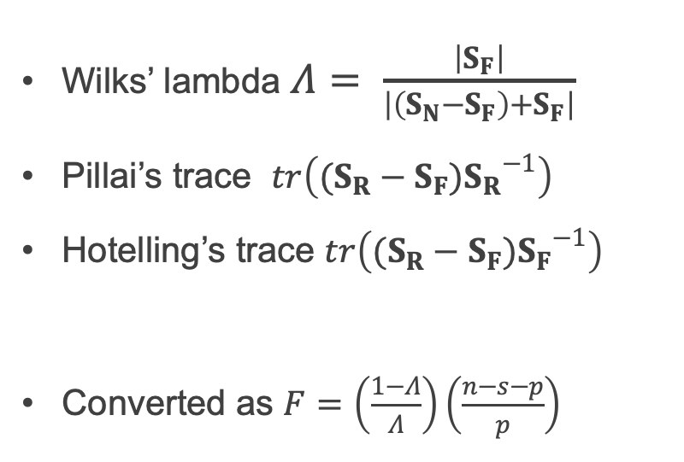
However: there is no multivariate F distribution! Solutions:
Use multivariate approximations and then apply a conversion to an approximate F-value
Wilks’ lambda $Λ= \frac{\left|S_{F}\right|}{\left|\left(S_{N}−S_{F}\right)+S_{F}\right|}$
Pillai’s trace $tr\left((S_{R}−S_{F}){S_{R}}^{−1}\right)$
Hotelling’s trace $tr\left((S_{R}−S_{F}){S_{F}}^{−1}\right)$
Converted as $F=\left(\frac{1−Λ}{Λ}\right)\left(\frac{n−s−p}{p}\right)$
n: total sample size, s: ncol(Xr), ncol(Y)
Anderson MJ, Ter Braak CJF (2003). Journal of Statistical Computation and Simulation 73: 85-113

Slide 8

However: there is no multivariate F distribution! Solutions:
Use multivariate approximations and then apply a conversion to an approximate F-value
Wilks’ lambda $Λ= \frac{\left|S_{F}\right|}{\left|\left(S_{N}−S_{F}\right)+S_{F}\right|}$
Pillai’s trace $tr\left((S_{R}−S_{F}){S_{R}}^{−1}\right)$
Hotelling’s trace $tr\left((S_{R}−S_{F}){S_{F}}^{−1}\right)$
Converted as $F=\left(\frac{1−Λ}{Λ}\right)\left(\frac{n−s−p}{p}\right)$
“Traditional” test statistics
Require n >> p
n: total sample size, s: ncol(Xr), ncol(Y)
Anderson MJ, Ter Braak CJF (2003). Journal of Statistical Computation and Simulation 73: 85-113

Slide 9
However: there is no multivariate F distribution! Solutions:
Use multivariate approximations and then apply a conversion to an approximate F-value
Use randomizations to obtain an empirical distribution
Wilks’ lambda $Λ= \frac{\left|S_{F}\right|}{\left|\left(S_{N}−S_{F}\right)+S_{F}\right|}$
Pillai’s trace $tr\left((S_{R}−S_{F}){S_{R}}^{−1}\right)$
Hotelling’s trace $tr\left((S_{R}−S_{F}){S_{F}}^{−1}\right)$
Converted as $F=\left(\frac{1−Λ}{Λ}\right)\left(\frac{n−s−p}{p}\right)$
“Traditional” test statistics
Require n >> p
Use randomization procedures, which are more powerful for high-dimensional data
n: total sample size, s: ncol(Xr), ncol(Y)
Anderson MJ, Ter Braak CJF (2003). Journal of Statistical Computation and Simulation 73: 85-113

